Slide 1

Guided By: Submitted By: Prof. Nisha Rathi Aman Sharma Prof. Vandana Kate Aniket Tiwari Vidhi Sethiya
WATCHFUL EYE
Suspicious Activity Detection
from CCTV Surveillance Videos

Slide 2
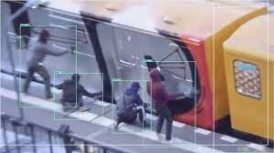

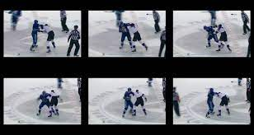
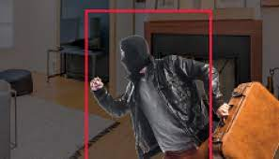
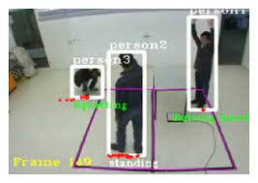
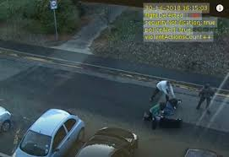
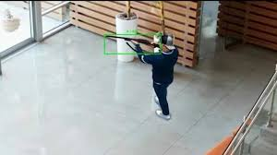
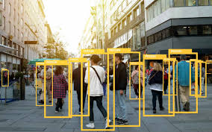
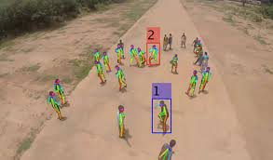

Slide 3
PROJECT CATEGORY
Machine Learning and Computer Vision
Computer Vision in Surveillance
Computer vision is an application of machine learning and artificial intelligence that takes information from digital images and videos and makes meaningful decisions based on that information
With the widespread use of security cameras in public places, AI video analysis and scene understanding with computer vision have become essential features of surveillance systems.

Slide 4
PROJECT CATEGORY
Use Cases
anomaly detection
object detection and tracking
movement analysis technologies
monitoring systems
prevention, identification, and warning systems

Slide 5
PROBLEM STATEMENT
The problem definition of a project on suspicious activity detection is to develop algorithms and techniques that can accurately detect suspicious activities in video surveillance footage.
The detection of activities that may be considered suspicious or abnormal within a given environment. This can include various types of activities, such as Mischief, Theft or Fighting etc.
The goal is to automate the process of suspicious activity detection and reduce the need for human surveillance, thereby improving the effectiveness and efficiency of security measures in various fields.

Slide 6
EXSISTING SYSTEMS
There are various suspicious activity detection methods from CCTV footage. Some of the most common ones are:
1. Motion Detection: This method involves detecting any movement in the CCTV footage. The system compares consecutive frames of the video and flags any changes as suspicious activity.
2. Object Detection: This method involves detecting any object that appears in the CCTV footage. The system identifies the objects and their movements and flags any abnormal activity.
3. Crowd Analysis: This method involves analyzing the behavior of crowds in the CCTV footage. The system looks for any unusual behavior, such as overcrowding or sudden changes in movement patterns, and flags it as suspicious.

Slide 7
WHAT IS OUR PROJECT IDEA
Why Suspicious Activity Detection?
Suspicious human activity recognition from surveillance video is an active research area of image processing and computer vision.
Through the visual surveillance, human activities can be monitored in sensitive and public areas.
It involves recognition of human activity and categorizes them into normal and abnormal activities.
Abnormal activities are the unusual or suspicious activities rarely performed by the human at public places, such as left luggage for explosive attacks, theft, running crowd, fights and attacks, vandalism and crossing borders.

Slide 8
PROPOSED METHODOLOGY
INPUT
Dataset Preparation
PROCESS
Data Preprocessing
Model Training
OUTPUT
Suspicious activity detection

Slide 9
WHAT DOES IT DO ?
7 Normal 13 Stealing
8 Robbery
9 Shooting
10 Shoplifting
11 Stealing
12 Vandalism
The model will classify the result into following classes
0 Abuse
1 Arrest
2 Arson
3 Assault
4 Burglary
5 Explosion
6 Fighting

Slide 10
SDLC
The Software Development Life Cycle (SDLC) for suspicious activity detection from CCTV footage can be broken down into the following stages:
Requirements Gathering: This stage involves understanding the requirements of the client, such as the type of suspicious activity to be detected, the accuracy rate required, and the number of cameras to be used.
System Design: Based on the requirements, the system architecture and design are created. This includes the choice of hardware and software components and the integration of different algorithms for suspicious activity detection.
Implementation: The implementation stage involves developing the software based on the design. This includes coding the algorithms and integrating them into the system.

Slide 11
SDLC
Testing: Once the implementation is complete, the system is tested for functionality, performance, and accuracy. Testing is carried out in different scenarios to ensure the system works effectively in real-world conditions.
Deployment: After testing, the system is deployed in the client's environment. This involves installing the hardware and software components and configuring the system to the client's requirements.
Throughout the SDLC, it is important to involve the client in each stage to ensure the system meets their requirements. Additionally, it is essential to follow industry best practices for software development, such as coding standards and documentation, to ensure the system is reliable, scalable, and maintainable.

Slide 12
SOFTWARE AND HARDWARE REQUIREMENTS
Software Requirements:
Operating System: The system should be compatible with the operating system used by the client, such as Windows, Linux, or macOS.
Machine Learning Frameworks: Machine learning frameworks such as TensorFlow, Keras are used to build and train machine learning models for suspicious activity detection.
Computer Vision Libraries: Computer vision library OpenCV is used to implement algorithms for object detection, motion detection, and facial recognition.
Hardware Requirements:
CPU and GPU: The system should have a powerful CPU and GPU to handle the processing requirements of real-time video analysis. Modern Operating System: Windows 10, Mac OS, Linux2. x86 64-bit CPU (Intel/AMD architecture)
Storage: The system should have sufficient storage to store the video data captured

Slide 13
FUNCTIONAL REQUIREMENTS
Here are some functional requirements:
Real-time video processing: The system should be able to process video data in real-time from multiple CCTV cameras.
Object Detection: The system should be able to detect and track objects in the video, including people and vehicles.
Motion Detection: The system should be able to detect any unusual or suspicious motion, such as running or erratic movements.
Facial Recognition: The system should be able to recognize faces in the video and match them against a database of known suspects.
Event Triggering: The system should be able to trigger an alert or notification when suspicious activity is detected.

Slide 14
NON FUNCTIONAL REQUIREMENTS
Here are some non functional requirements:
Reliability: The system should be reliable and operate without any errors or downtime.
Scalability: The system should be scalable to accommodate additional cameras and users as required.
Performance: The system should be able to handle the processing requirements of real-time video analysis without any lag or delays.
Security: The system should be secure and protect the video data from unauthorized access or tampering.
Accuracy: The system should be accurate in detecting suspicious activity to reduce false positives and false negatives.

Slide 15
UML DIAGRAMS

Slide 16
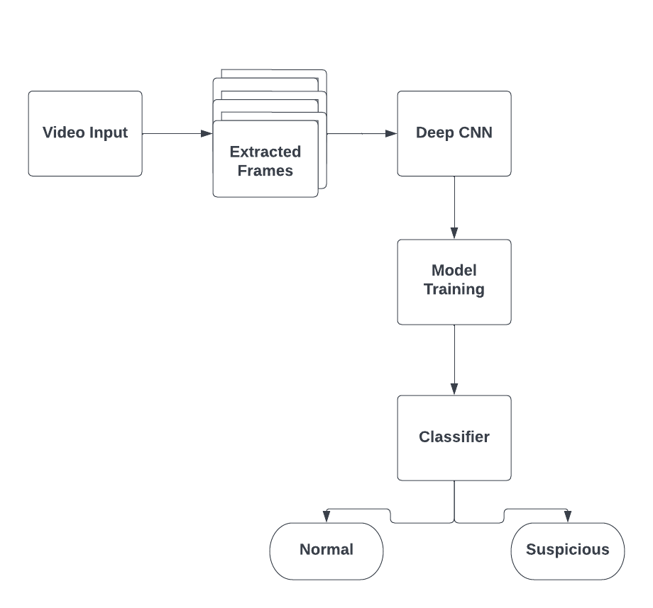

Slide 17
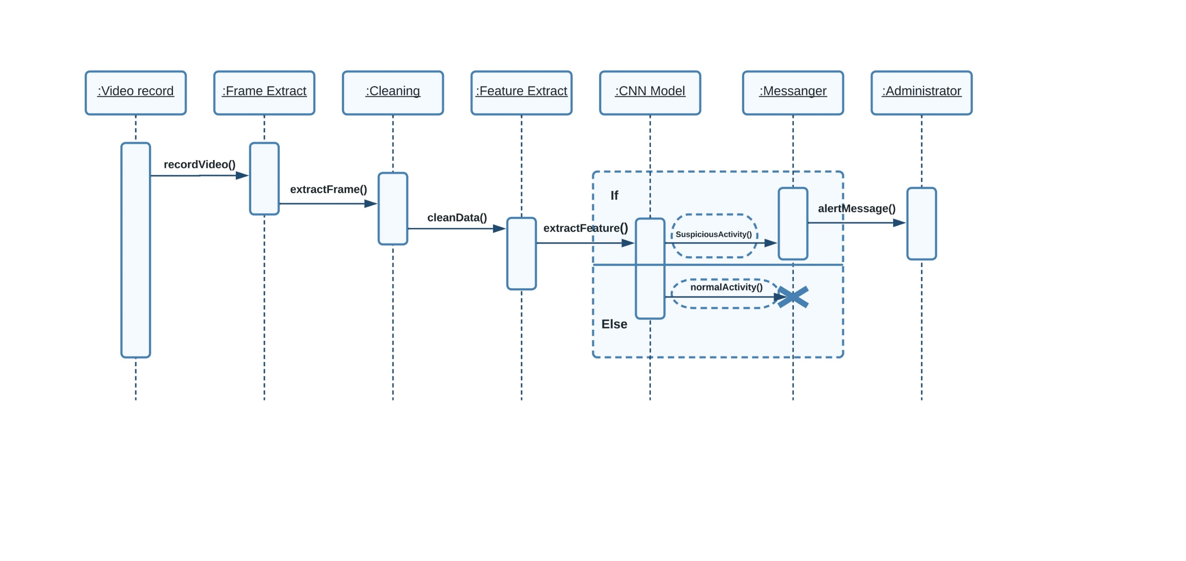

Slide 18
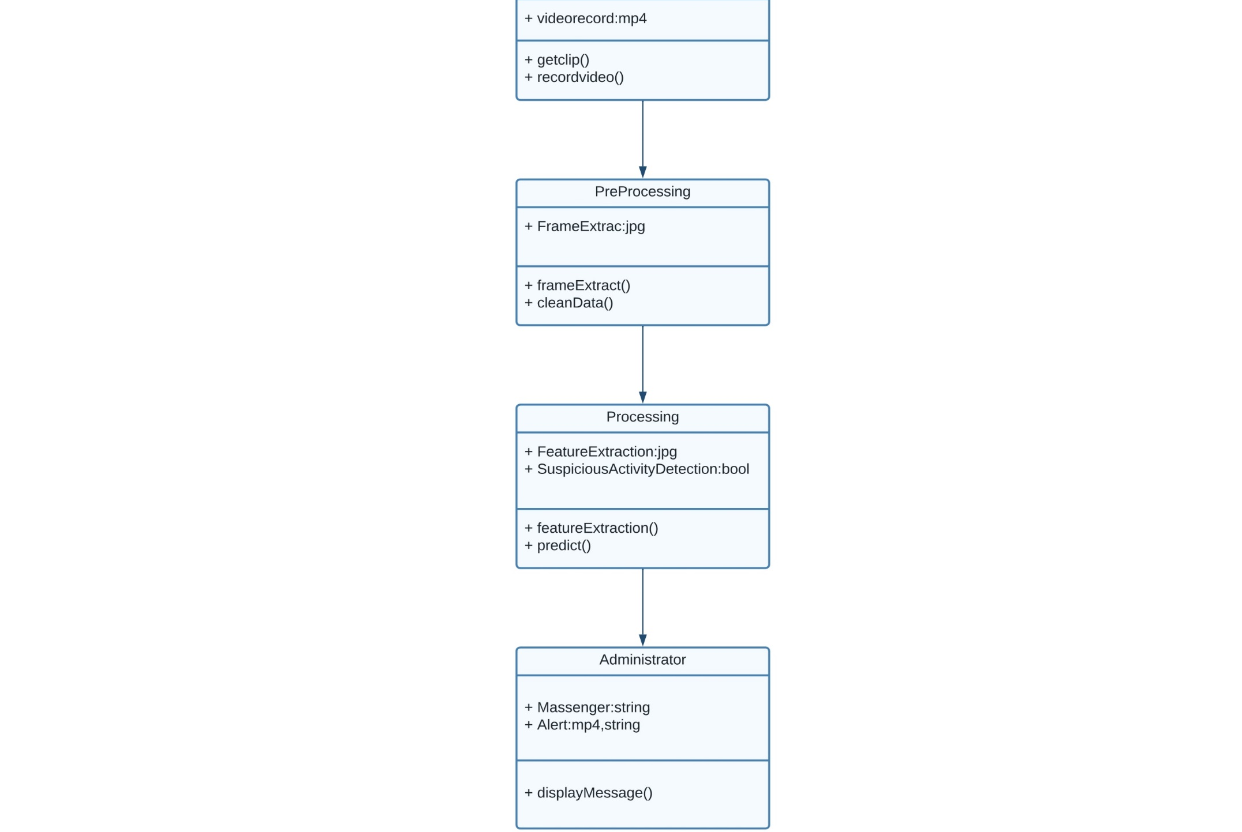

Slide 19
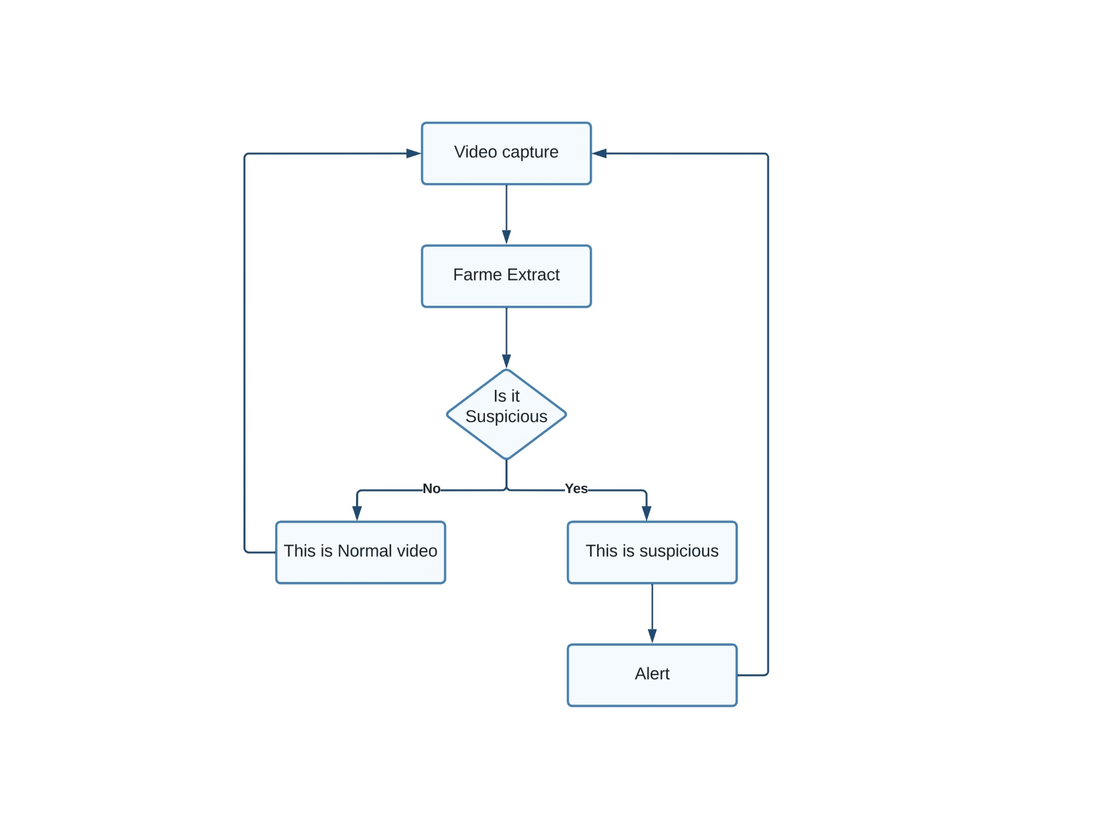

Slide 20
DATASET
Name: UFC Crime Dataset
Source: Kaggle
About Dataset:
The dataset contains images based on the following 14 classes: Abuse, Arrest, Arson, Assault, Accident, Burglary, Explosion, Fighting, Robbery, Shooting, Stealing, Shoplifting, and Vandalism.

Slide 21
TRANSFER LEARNING
What Is Transfer Learning?
Transfer learning generally refers to a process where a model trained on one problem is used in some way on a second related problem.
In deep learning, transfer learning is a technique whereby a neural network model is first trained on a problem similar to the problem that is being solved. One or more layers from the trained model are then used in a new model trained on the problem of interest.

Slide 22
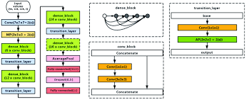
MODEL USED
DESNET121
DenseNet-121 has 120 Convolutions and 4 AvgPool. All layers i.e. those within the same dense block and transition layers, spread their weights over multiple inputs which allows deeper layers to use features extracted early on

Slide 23
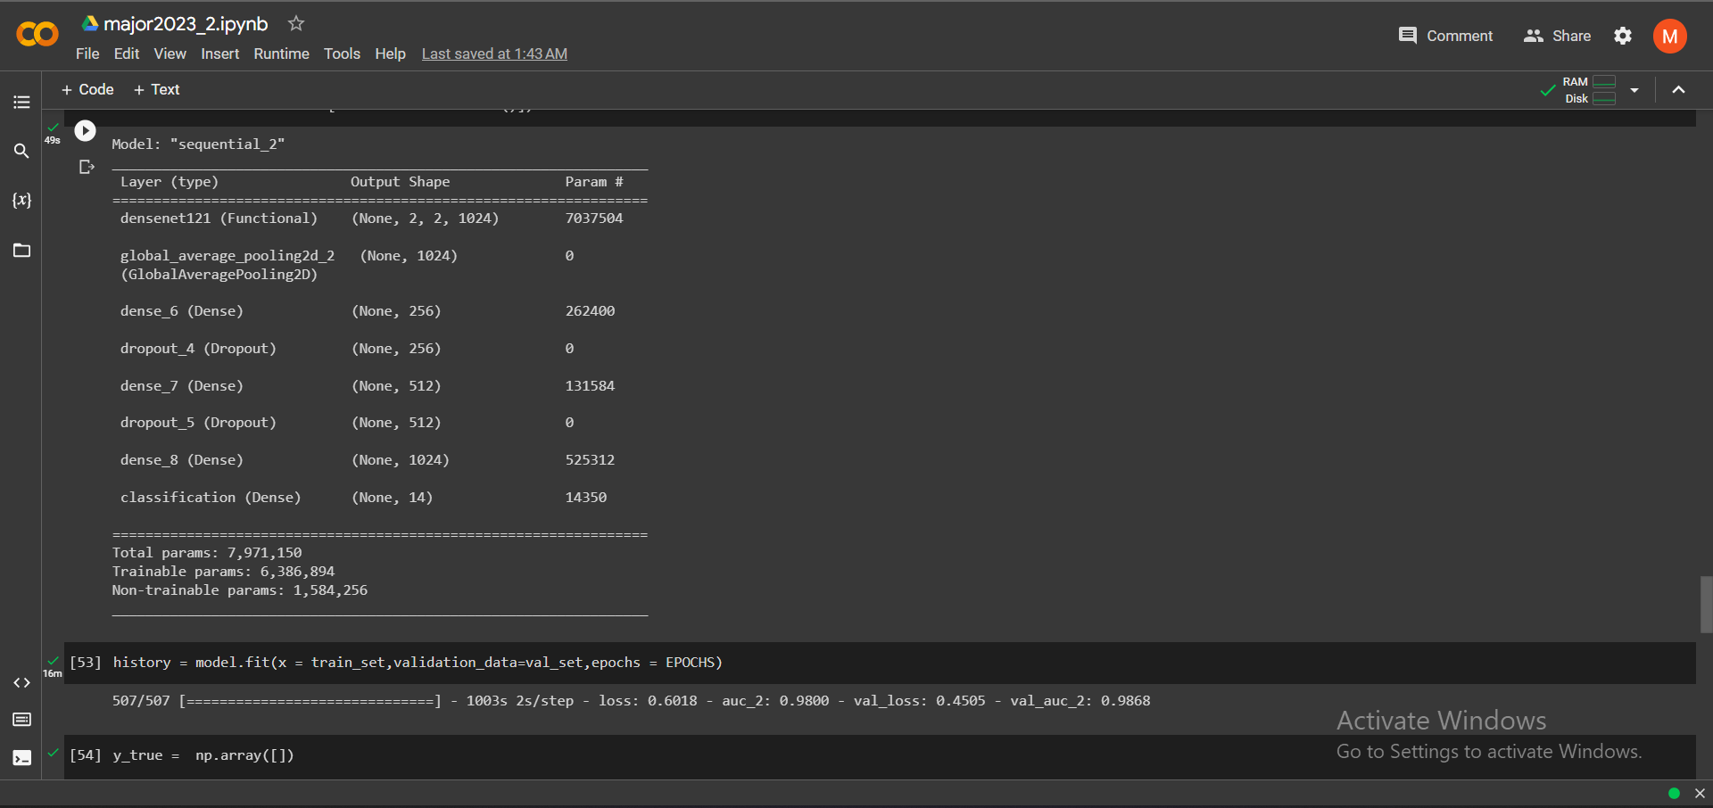
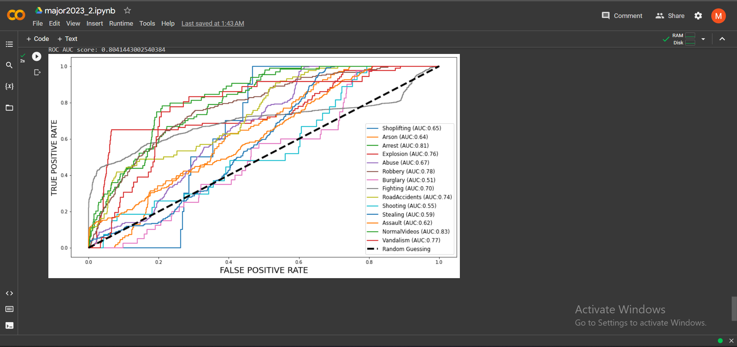
PROJECT IMPLEMENTATION

Slide 24
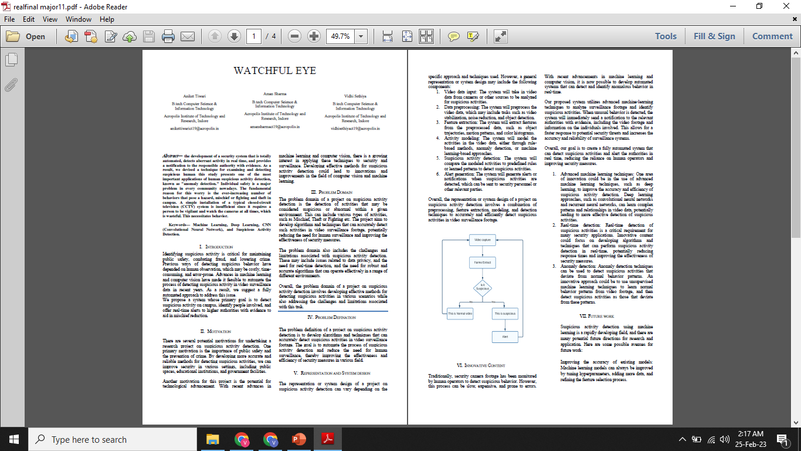
RESEARCH PAPER

Slide 25
REFRENCES
[1] Joey Tianyi Zhou, Jiawei Du, Hongyuan Zhu, Xi Peng, Rick Siow Mong Goh, ”AnomalyNet: An Anomaly Detection Network for Video Surveillance, 2019.
[2] Monika D. Rokade and Tejashri S. Bora, "Survey On Anomaly Detection for Video Surveillance" 2021 International Research Journal of Engineering and Technology(IRJET).
[3] Jefferson Ryan Medel, Andreas Savakis, “Anomaly Detection in Video Using Predictive Convolutional Long Short-Term Memory Networks” under review.
[4] W. Luo, W. Liu, and S. Gao, “A revisit of sparse coding based anomaly detection in stacked rnn framework,” in The IEEE International Conference on Computer Vision (ICCV), Oct 2017
[5] Y. S. Chong and Y. H. Tay, “Abnormal event detection in videos using spatiotemporal autoencoder,” in International Symposium on Neural Networks. Springer, 2017, pp. 189–196
[6] Tejashri Subhash Bora1 , Monika Dhananjay Rokade2, “HUMAN SUSPICIOUS ACTIVITY DETECTION SYSTEM USING CNN MODEL FOR VIDEO SURVEILLANCE”,2021

Slide 26
THANK YOU

